Slide 1
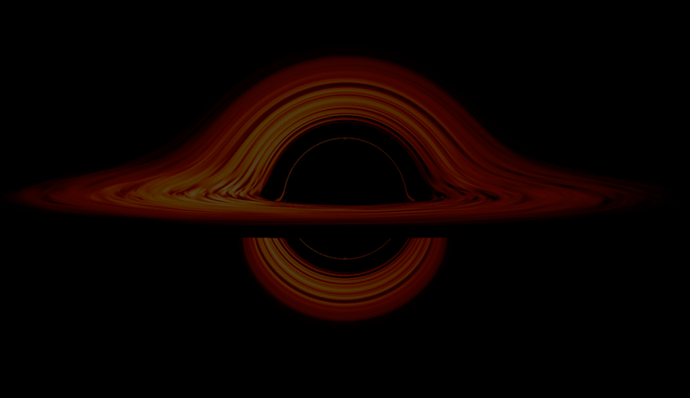

Probing Early Supermassive Black Hole Growth:
C IV-Based Mass Estimates in z ~ 4.8 Quasars
Nayera Abdessalam
Advised By: Dr. Richard Green &
Dr. Weizhe Liu
Arizona Space Grant Consortium Symposium
April 18th, 2026
Notes:
Background image credit: https://svs.gsfc.nasa.gov/13326

Slide 2
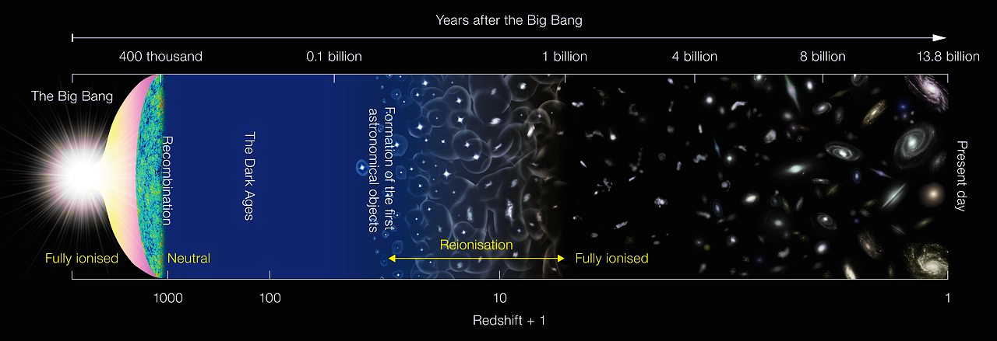
How do supermassive black holes (SMBHs) evolve in the first billion years after the Big Bang?
Our Sample
Years after the Big Bang
Redshift + 1
Source: NASA

Slide 3
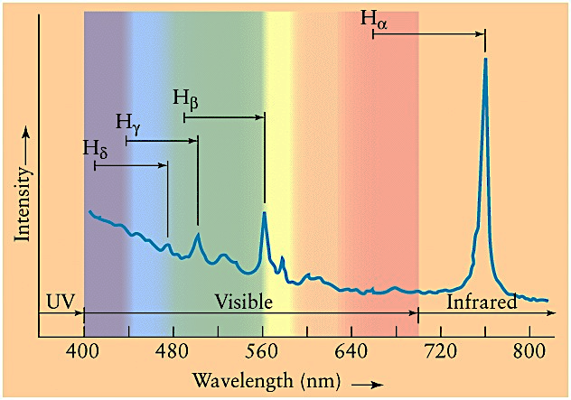
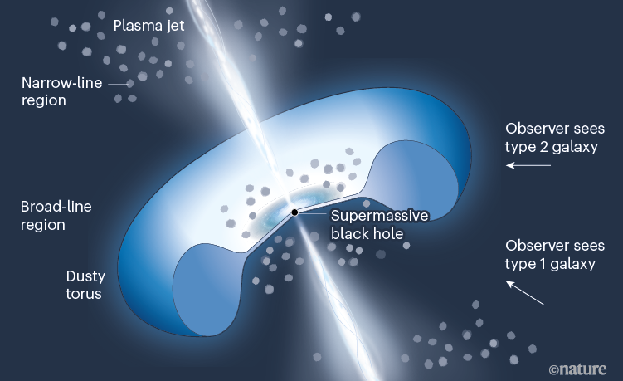
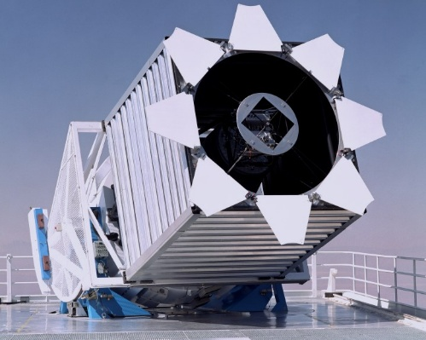
Background
Redshift (z): how far back in time we’re seeing
Quasar: luminous gas/dust feeding a black hole
Spectroscopy: measuring light intensity as a function of wavelength
Quasar 3C 273 Spectrum
Source: Antonucci 2022
Mass Estimates
Source: SDSS
Notes:
SMBH extreme gravity -> Matter pulled in (but not all of it -> gas and dust rotating SMBH (hot & bright) -> light travels through space -> measured with telescopes on Earth

Slide 4
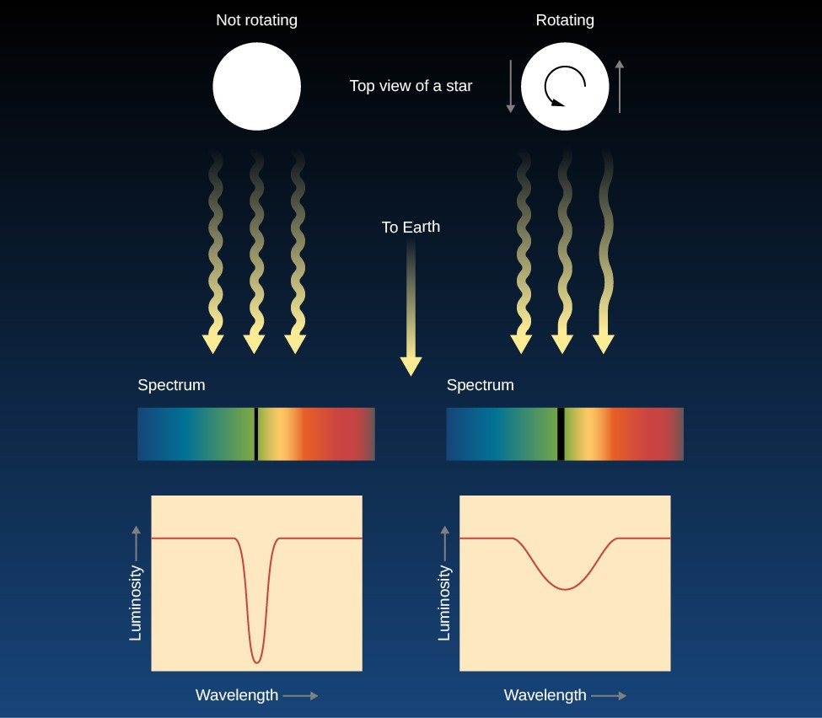
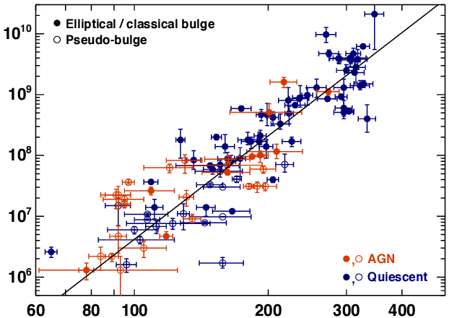
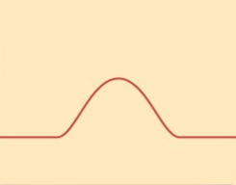
Objectives
Compare mass measurements of SMBHs made from line widths of triply ionized Carbon (C IV) versus excited neutral Hydrogen (Hβ)
Adjust C IV measurements with known correction techniques
Source: Heckman & Best 2014
Top view of a black hole
Black hole mass (from Hβ)
Source: Lumen Learning
Velocity dispersion [km/s]
Notes:
Speaking notes:
Both lines come from gas around the black hole, but Hβ traces more stable, gravitational motion, while C IV is affected by winds and outflows
Emphasize velocity and how we get from gas movements to broad emission line
Use graphic to shows how hb masses measures were made/correlated, show that it has been redshifted (from Wenwen or Vestergaard) : h beta as a mass calibrator (it is straight line)
CIV λ = 1549 Å,
Hb λ = 4861 Å

Slide 5
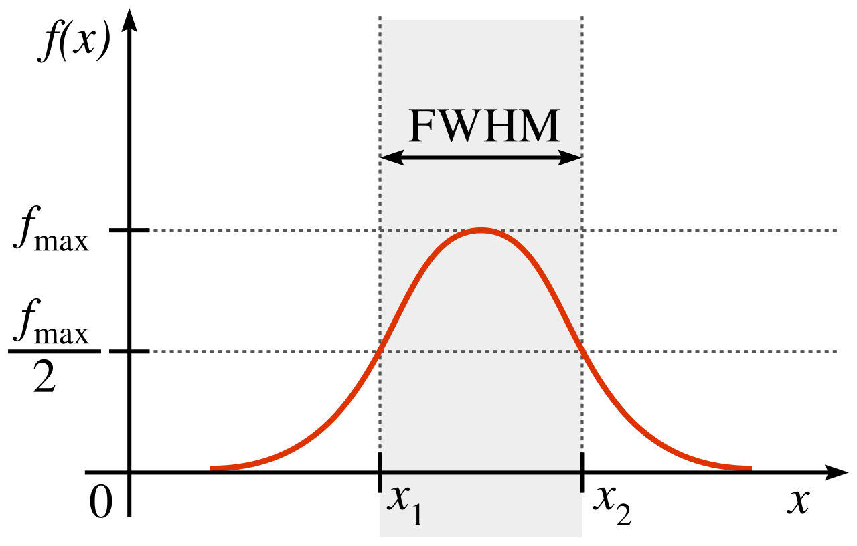
Sample & Methods
14 Quasar Spectra, z ~ 4.8
C IV optical data from Sloan Digital Sky Survey
Hβ infrared data from James Webb Space Telescope (JWST)
Line fitting:
  Full width at half max (FWHM)
  Blueshift
  Bayesian Information Criterion (BIC)
Source: Norro

Slide 6
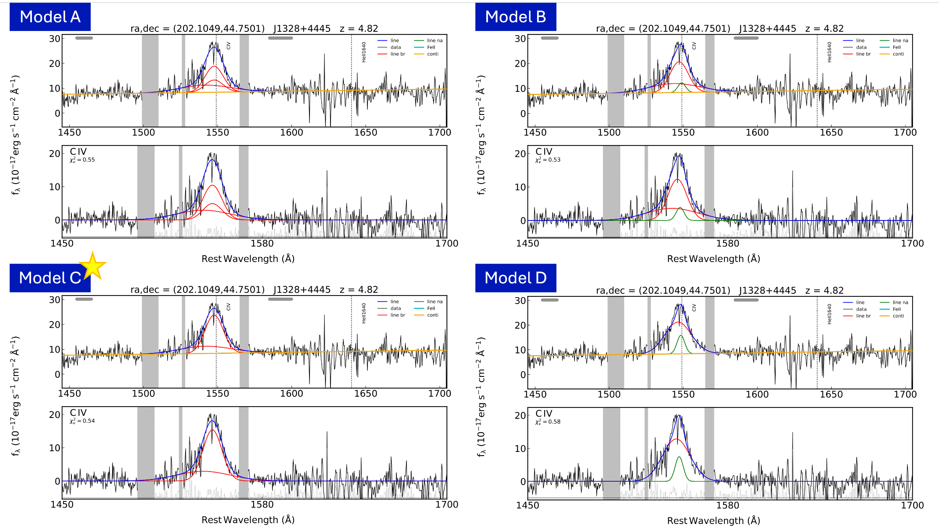
Sample & Methods
Notes:
Luminosity -> radius
Line width -> motion

Slide 7
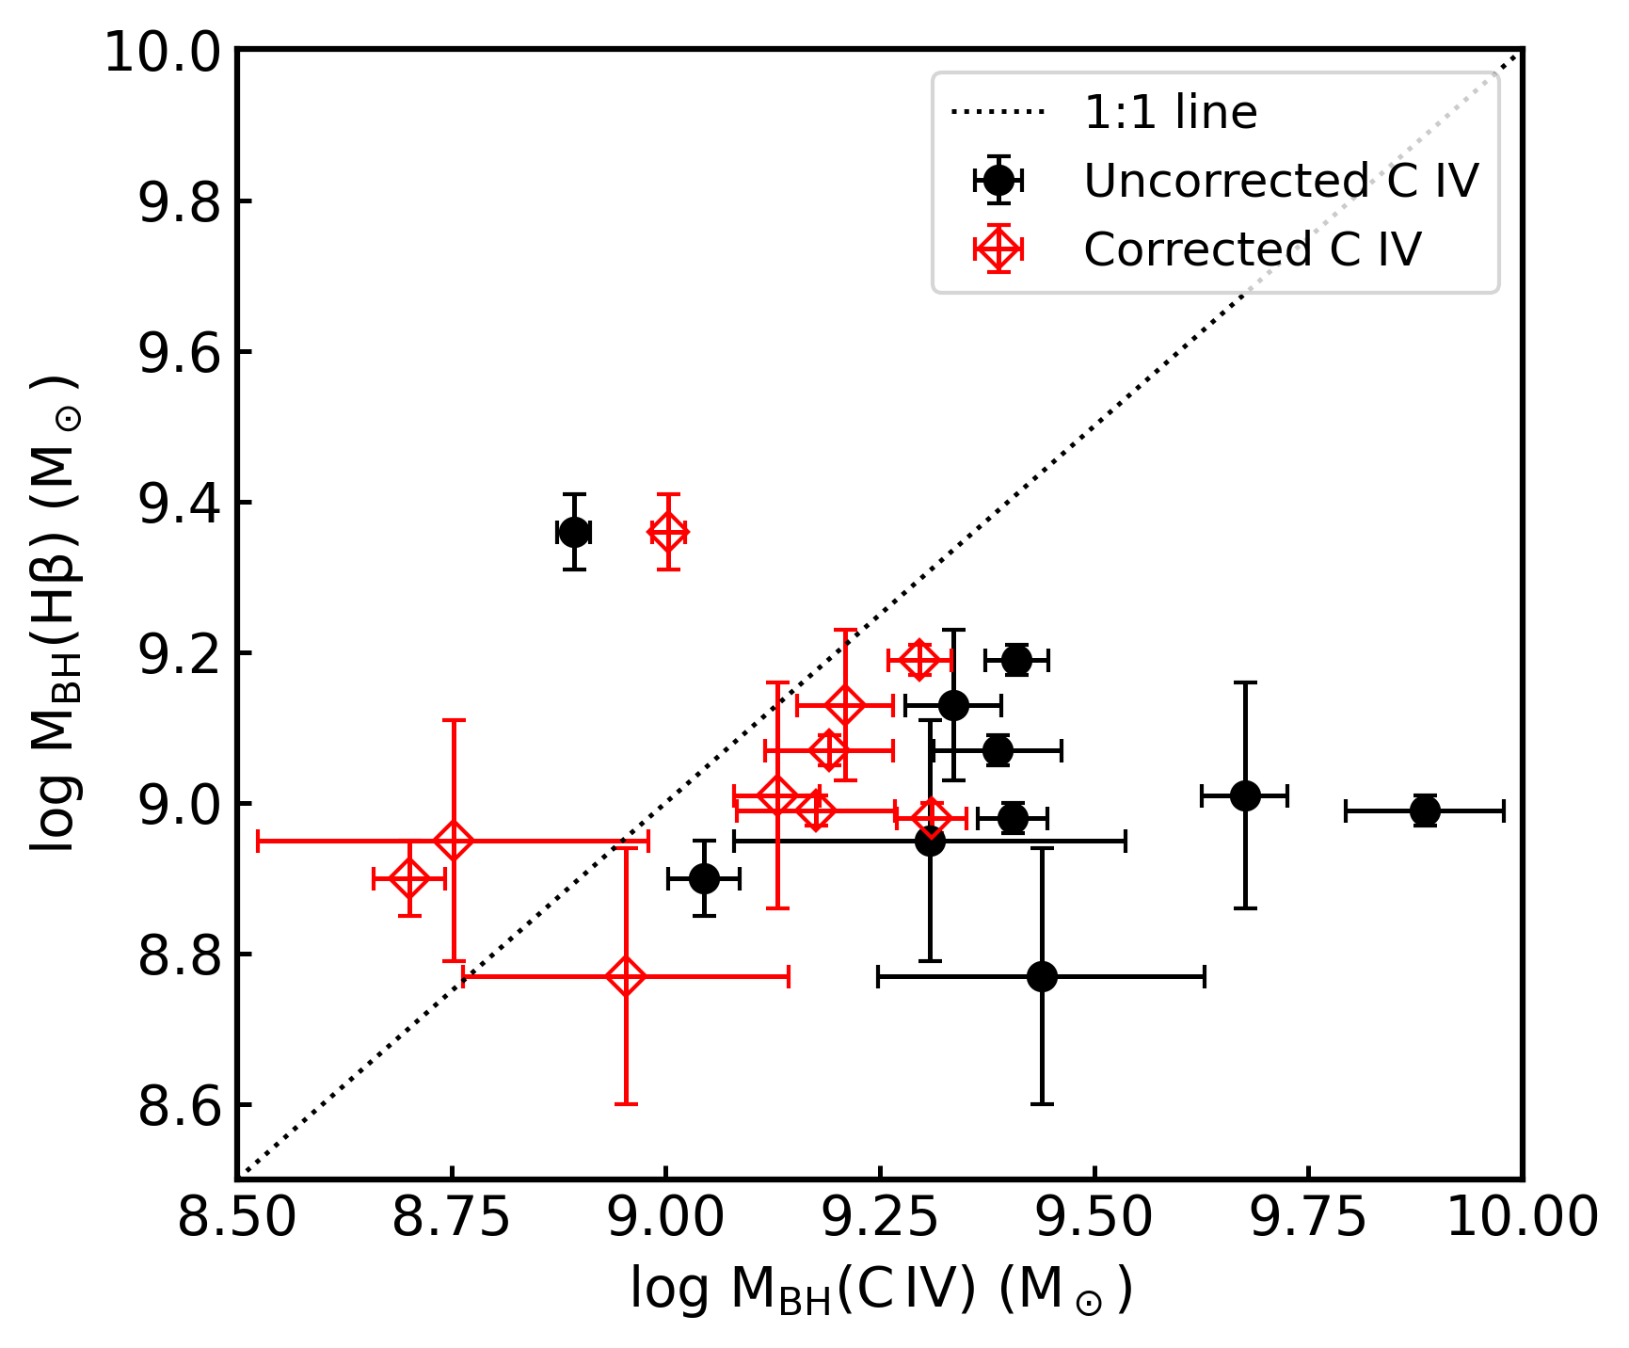
Key Results
*Typical systematic uncertainty ≈ 0.4 dex, not included on plot

Slide 8
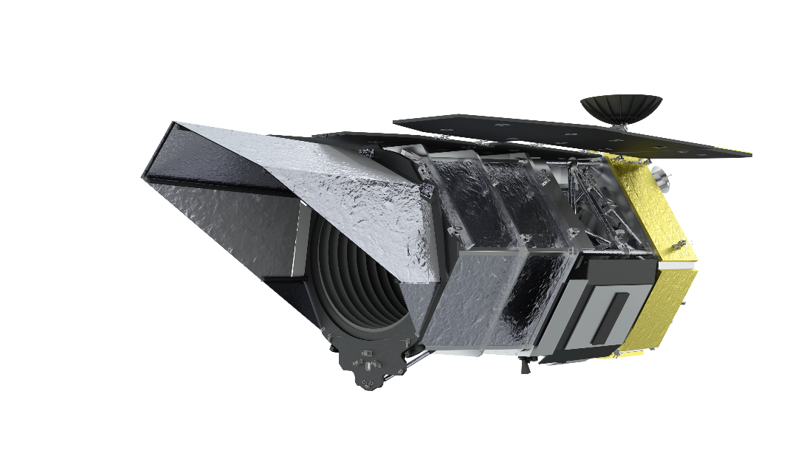
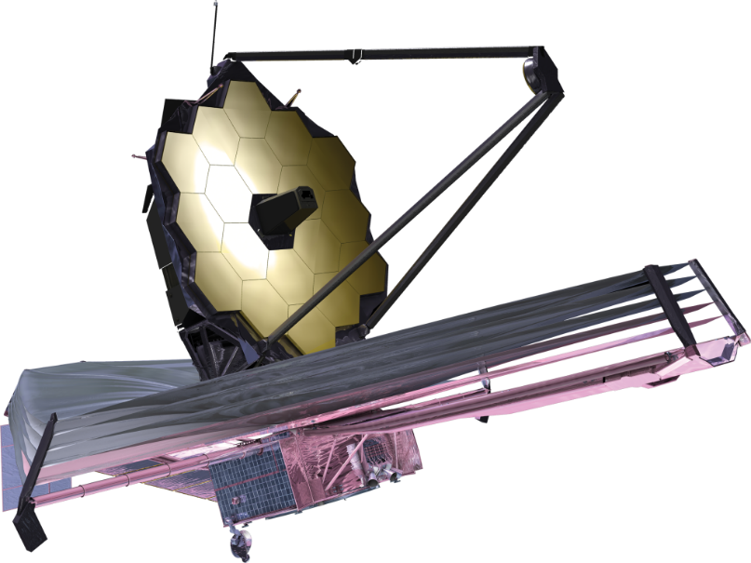

Conclusions & Next Steps
Corrected C IV mass measurements are successful at singling out the gravitational motion of quasar (which traces mass)
Future study with JWST data at higher redshift
SPHEREx mission (recently launched)
Nany Grace Roman telescope (late 2026)
Notes:
Test other factors effecting black hole mass corrections
Calibrating away specific motions from the gas that is not just the pure gravitational motion, we are succeeding somewhat well at getting out the extraneous motions. Specific other corrections depending on each motion

Slide 9
Acknowledgements
Thank you to my advisors and mentors, Dr. Richard Green and Dr. Weizhe Liu, for their continued support through this project. Their patience and guidance has been essential.
This research has been funded in part through
  Arizona NASA Space Grant Consortium, Cooperative Agreement 80NSSC25M7084
  University of Arizona W. A. Franke Honors College Exploratory Mini-Grant
  Generous donation from Mike Kaiserman

Slide 10
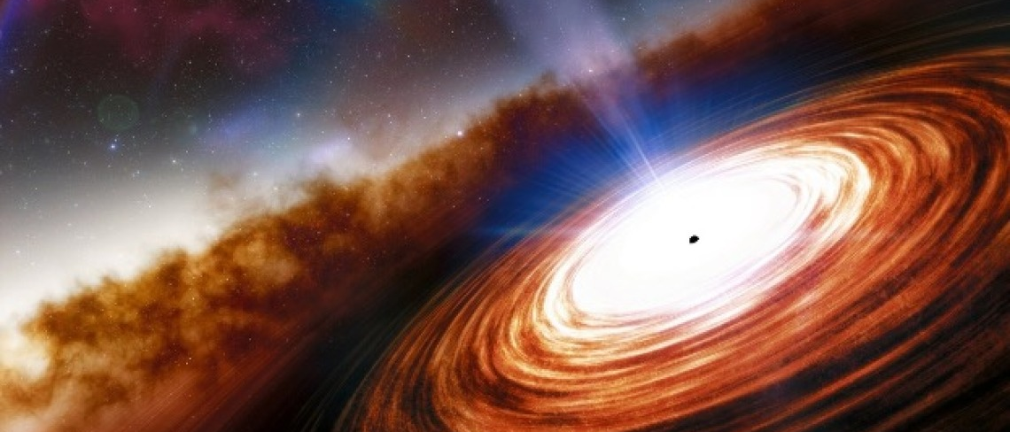
Thank you!
Source: NOIRLab/NSF/AURA/J. da Silva
Contact: nmabdessalam@arizona.edu

Slide 11
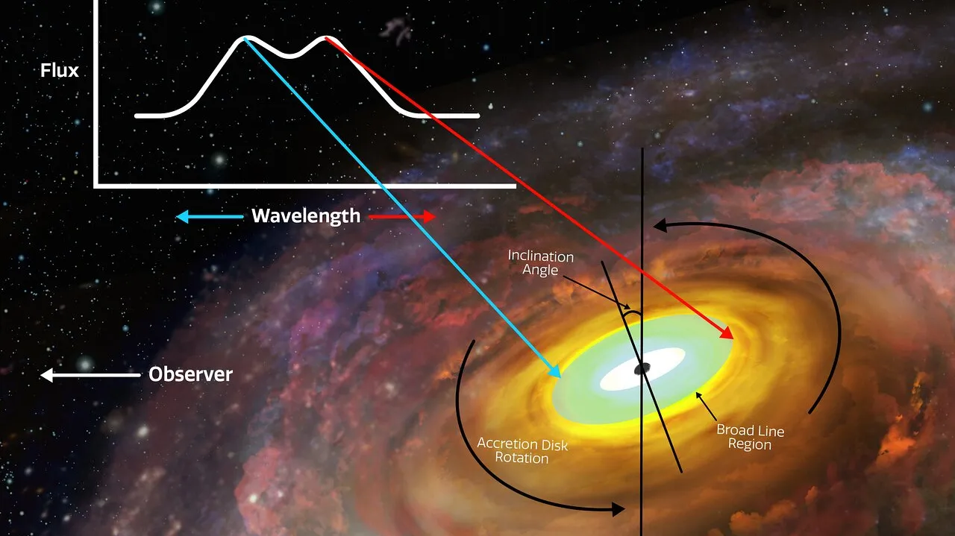
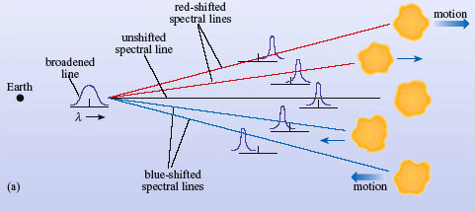

Slide 12
Source: Antonucci 2022

